Slide 1
Language Models as Inductive Reasoners
Zonglin Yang

Slide 2
Background
Finished in 2022
No previous works on generative inductive reasoning in NLP
Deriving explicit natural language hypotheses from observations
Connected to the philosophy literature
Definition of inductive reasoning
Requirements for inductive reasoning’s hypothesis
Connected to the classic AI literature
The previous computational paradigm for generative inductive reasoning
Systematic challenges

Slide 3
What is inductive reasoning?
Lack of formal definition in NLP
Definition handles by philosophy research
Definition [1]
The premise cannot provide conclusive support to its conclusion
The conclusion generalize over its premise in a way that the conclusion can be applied to more instances other than instances mentioned in its premise.
Example
If a white ball is found in a bag, then all balls in this bag are white.
The law of universal gravitation
Newton’s apple
More discussions on definition of deductive, inductive, and abductive reasoning can be found at [2].
[1] Flach, Peter A., and Antonis C. Kakas, eds. Abduction and Induction: Essays on their relation and integration. Vol. 18. Springer Science & Business Media, 2000.
[2] Yang, Zonglin, et al. "Logical reasoning over natural language as knowledge representation: A survey." arXiv preprint arXiv:2303.12023 (2023).

Slide 4
Motivation
No previous works on generative inductive reasoning in NLP
Deriving explicit natural language hypotheses from observations
Inductive Logic Programming
Formal language + symbolic reasoning
Systematic disadvantages
Heavily relying on human effort to transform raw information into formal language.
Very sensitive to label error.
Have no semantic understanding of symbols, low utilization of annotated data.
A new paradigm
Natural language + LLMs reasoning

Slide 5
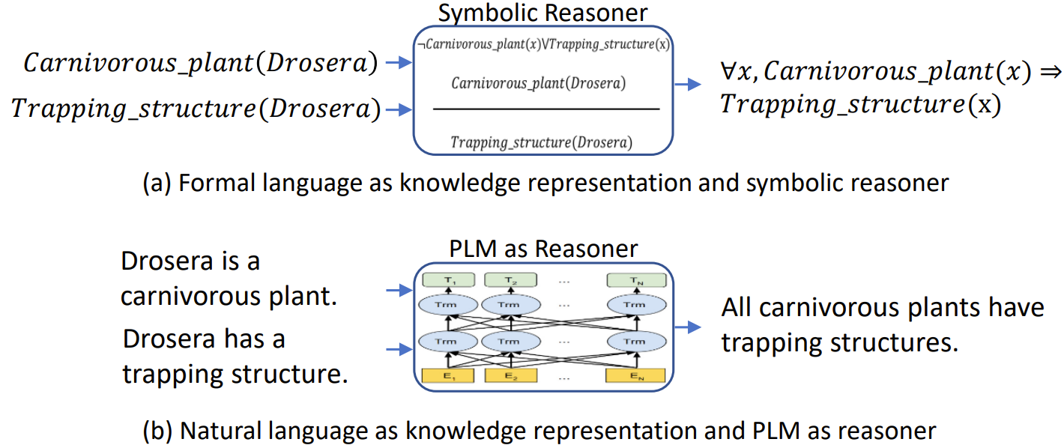
A new paradigm

Slide 6
Dataset construction
We construct a dataset (named DEER).
DEER is to analyze LLMs’ generative inductive reason ability.
DEER is fully constructed by an expert (an author of this paper).
DEER consists of 200 hypotheses, where each hypothesis is annotated with 3 short observations and 3 long observations.
Hypotheses written by the expert, cover 6 disciplines
Observations: unmodified online texts
DEER adopts a relatively open‐ended generation, rather than fixed options.

Slide 7
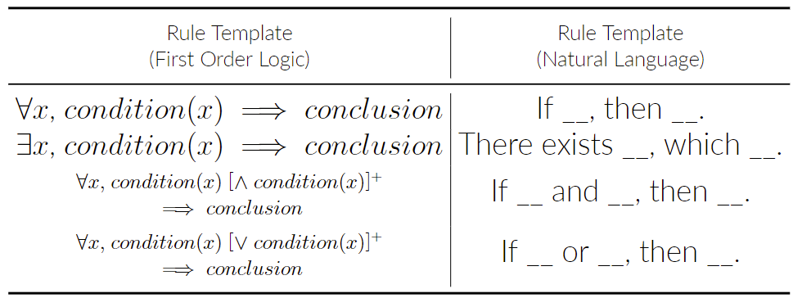
Rule Template

Slide 8
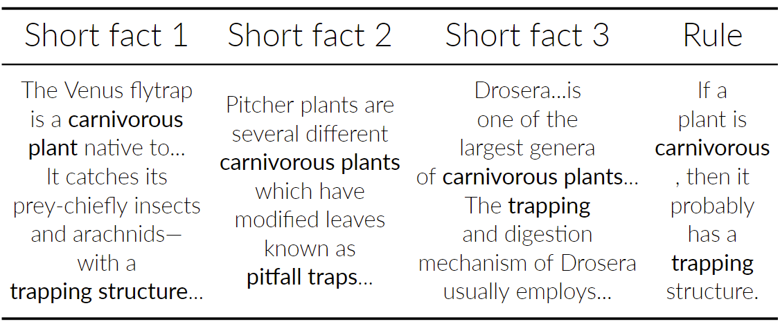
Dataset example

Slide 9
Requirements for inductive reasoning’s hypothesis
From philosophy literature [1]
The hypothesis should be deductively consistent with the observations.
The hypothesis should reflect the reality.
“indiscriminate conformation”
The hypothesis should generalize (covers a larger information scope) over the observations.
In the NLP context
The hypothesis should be clear and meaningful.
[1] Flach, Peter A., and Antonis C. Kakas, eds. Abduction and Induction: Essays on their relation and integration. Vol. 18. Springer Science & Business Media, 2000.

Slide 10
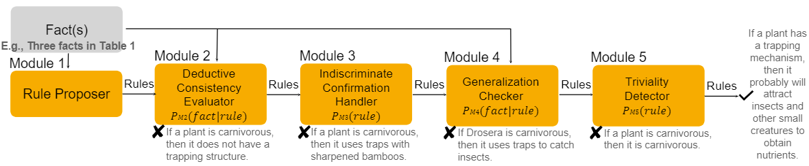
Method
CoLM: Chain of Language Models

Slide 11
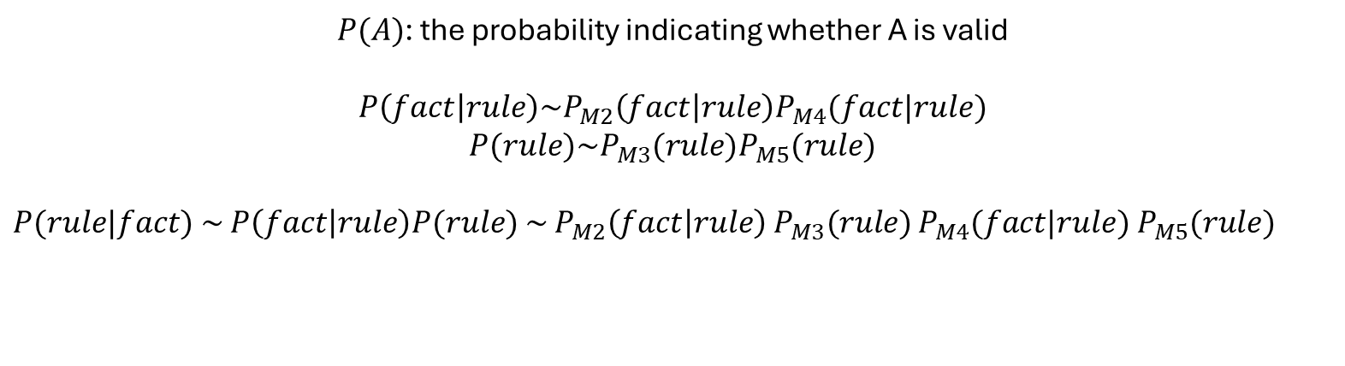
Method
CoLM: Chain of Language Models
$P(A)$: the probability indicating whether A is valid
$$P\left(fact | rule\right)\sim P_{M2}\left(fact | rule\right)P_{M4}(fact|rule)$$
$$P(rule)\sim P_{M3}(rule)P_{M5}(rule)$$
$P(rule|fact)$ $\sim$ $P\left(fact | rule\right)P(rule)$ $\sim$ $P_{M2}\left(fact | rule\right)$ $P_{M3}(rule)$ $P_{M4}(fact|rule)$ $P_{M5}(rule)$

Slide 12
Evaluation
Automatic evaluation
Human evaluation

Slide 13
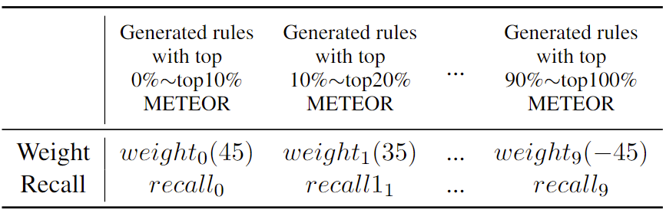


Automatic evaluation metrics
METEOR
Only evaluate the not filtered rules
Similar to “precision”
What about “recall”?
What about “f1”?

Slide 14
Human evaluation
According to requirements
The hypothesis should be deductively consistent with the observations.
The hypothesis should reflect the reality.
The hypothesis should generalize (covers a larger information scope) over the observations.
In the NLP context
The hypothesis should be clear and meaningful.
Only satisfy all four requirements, the rule is acceptable
Precision, recall, and f1

Slide 15
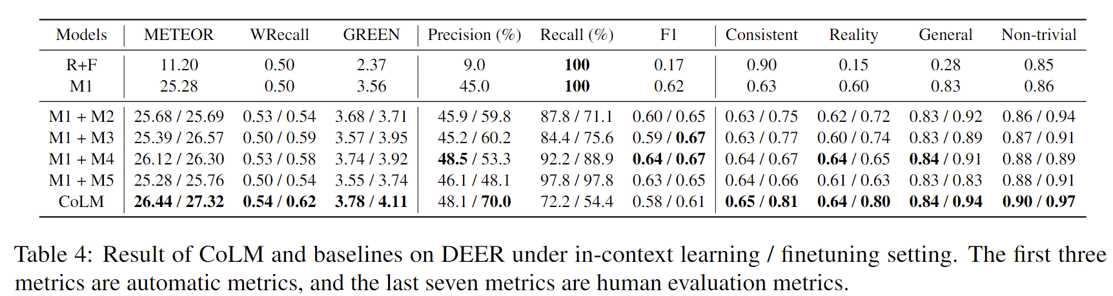
Main table

Slide 16
Comprehensive analysis
Regarding rule template
Regarding rule disciplines
Regarding types of input facts
Regarding LLM scale
Error analysis

Slide 17
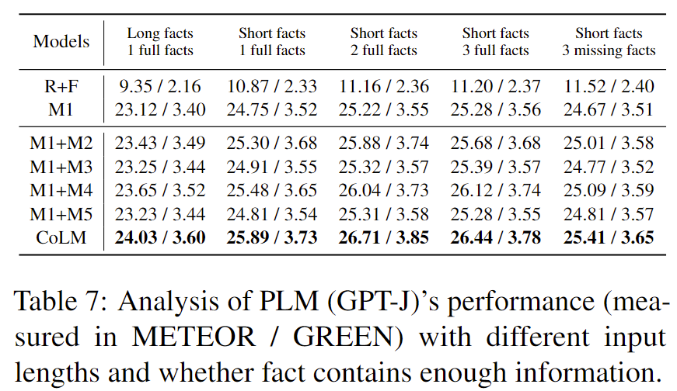
Regarding types of input facts

Slide 18
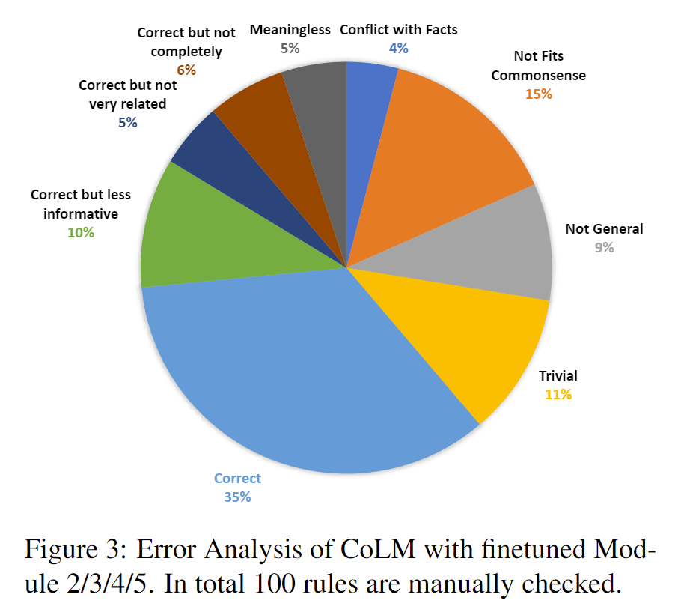
Error analysis

Slide 19
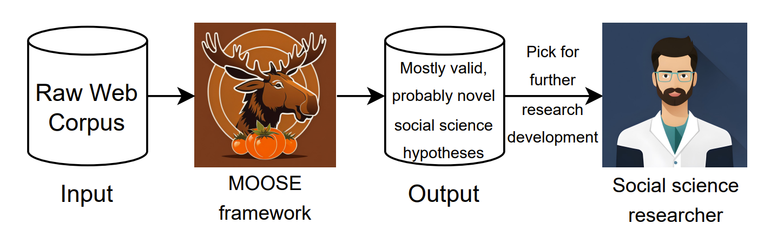
A further work
<Large Language Models for Automatic Open-domain Scientific Hypotheses Discovery>
With similar framework design with CoLM
The first work showing that LLMs can automatically generate high-quality and novel research hypotheses

